Slide 1
KAGGLE SURVEY DATA ANALYSIS AND INSIGHTS DERIVATION
BY
MANOJ C S

Slide 2
OVERVIEW
This Data Analysis and Insights derivation is done on the “Kaggle Machine Learning and Data Science Survey 2020” dataset.
This dataset is an open sourced dataset and is available in the Kaggle community
The main objective of this analysis is to tell a story about the subset of data science community represented in this survey through a combination of both narrative text and data exploration.
Link to the dataset: https://www.kaggle.com/c/kaggle-survey-2020/data

Slide 3
CONTENTS
Age Distribution
Gender Distribution
Country Distribution
Educational Qualifications
Job Roles Distribution
Programming Experience Distribution
Language for Beginners in Data Science
Computing Platform Usage Distribution
Big Data Products Usage Distribution
Business Intelligence Tools Distribution
Primary Data Analytics Tool
Money Spent on ML and Cloud Computing Services
TPU Usage Distribution
Experience in Machine Learning Methods

Slide 4
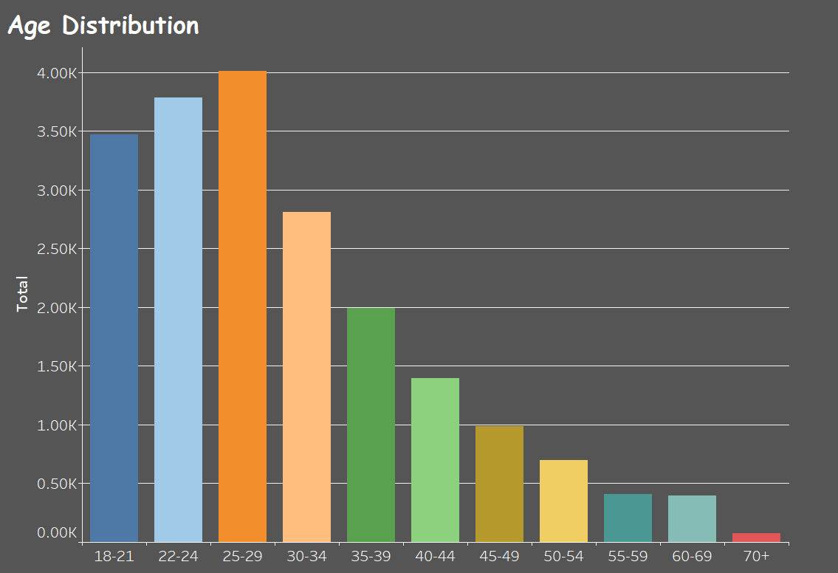
Age Distribution
It can be clearly understood from the graph that the developers of age group 18-34 is more in number when compared to all other age groups.
However the number of people decreases as the age group goes high.
From this, we can infer that the freshers and youths are more into data science than the experienced professionals or adults.

Slide 5
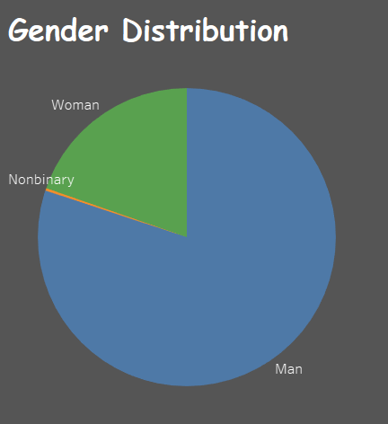
Gender Distribution
The number of males is very large when compared to women.
Almost 80% of people are of men and the rest 20% is women.
This indicates that the men are more interested in working in data science field when compared to women

Slide 6
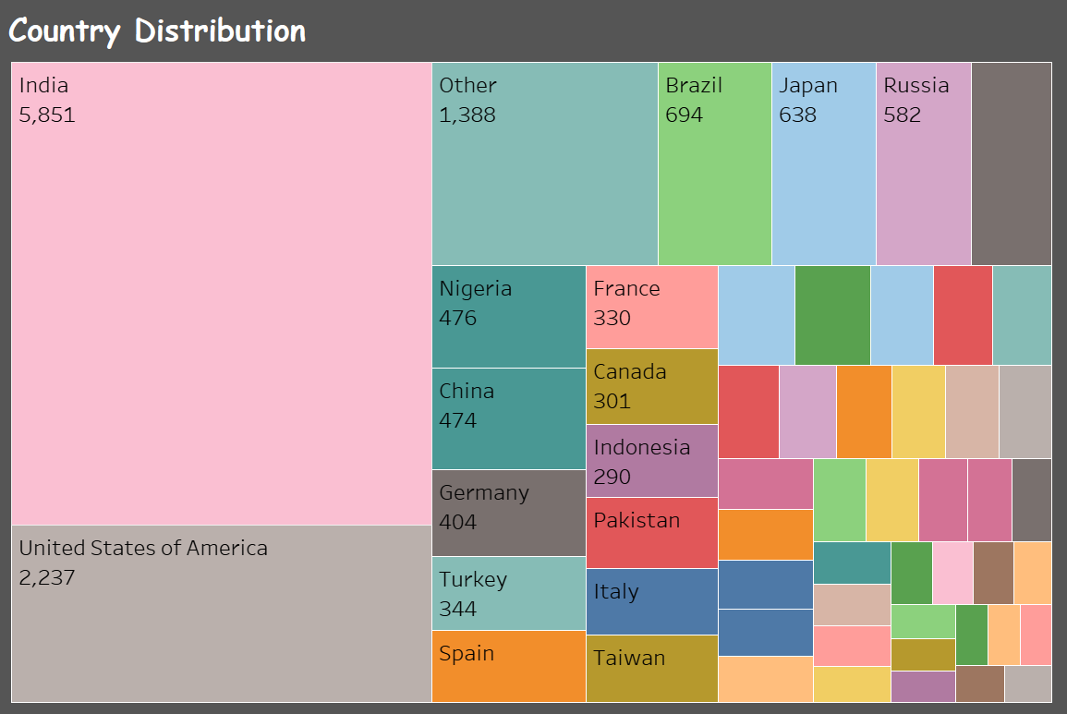
Country Distribution
People from almost 55 Countries participated in this Kaggle survey.
India and USA are among the top 2 countries which indicates that most of the data scientists are present there.

Slide 7
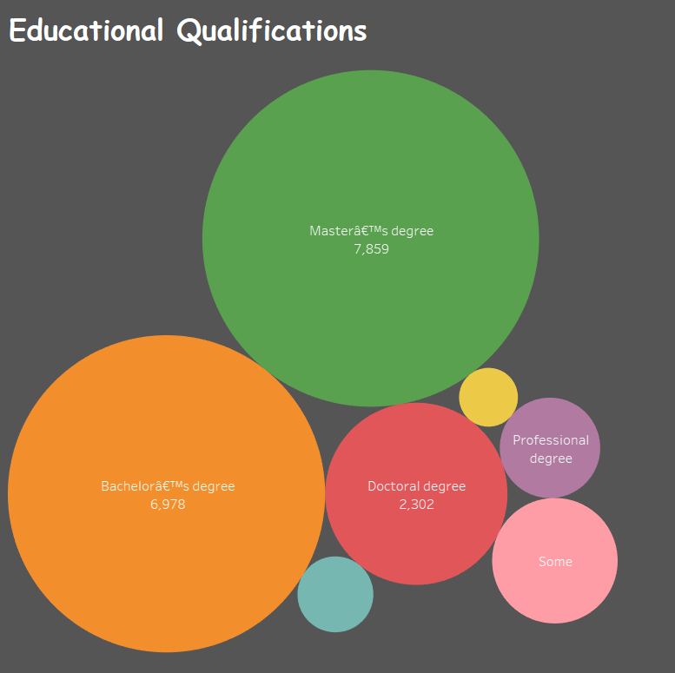
Educational Qualifications
The Developers with Masters Degree and Bachelors Degree are prominent compared to other degrees.
There are all kinds of degree holders and even non-degree holders in this survey which in turn indicates that Kaggle is used by all professionals and non-professionals as well.

Slide 8
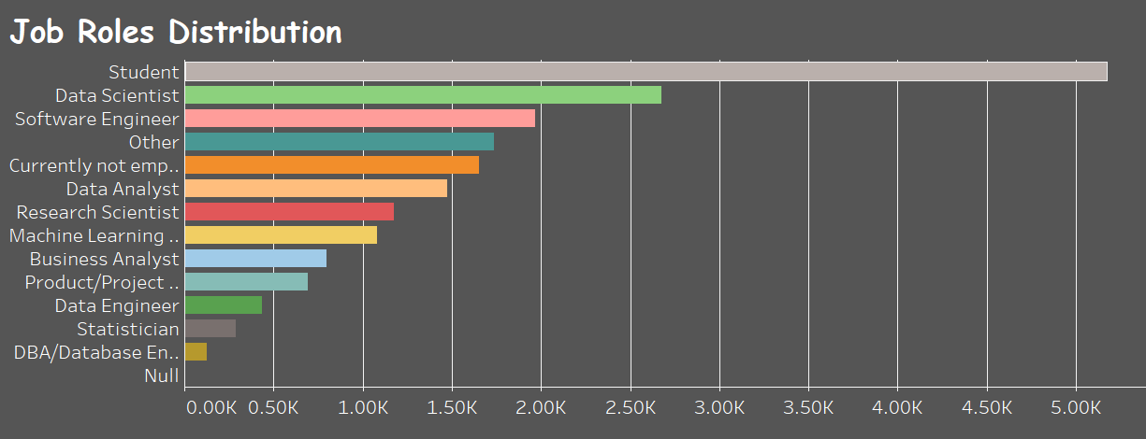
Job Roles Distribution
Students represent almost 25% of all the survey respondents.
Data scientist represent almost 15% of all the survey respondents.
People with different job roles have participated in this survey which is related to IT industry and Data Science.

Slide 9
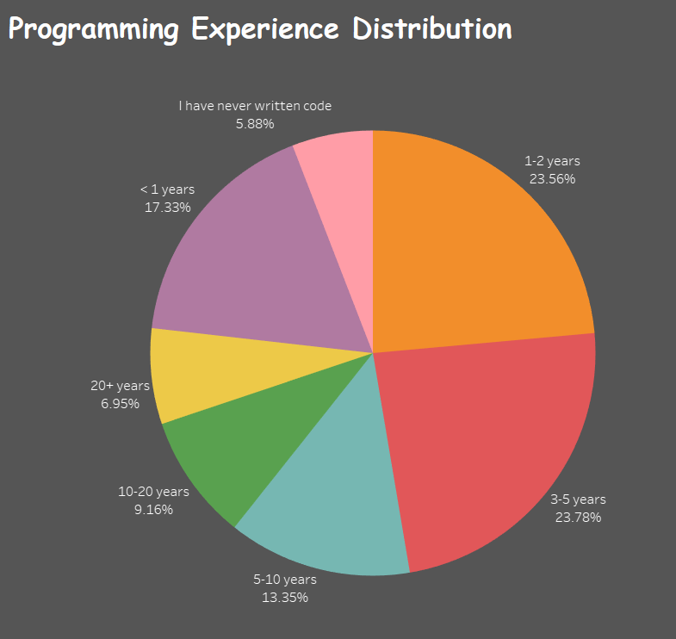
Programming Experience Distribution
People with below 5 years experience are more in number compared to all other experience groups.
People with 1-2 years experience comprise about 23 % and with 3-5 experience also comprise about 23%.
Almost 95% people in this survey have some experience in programming which is the basics for Data science and software development

Slide 10
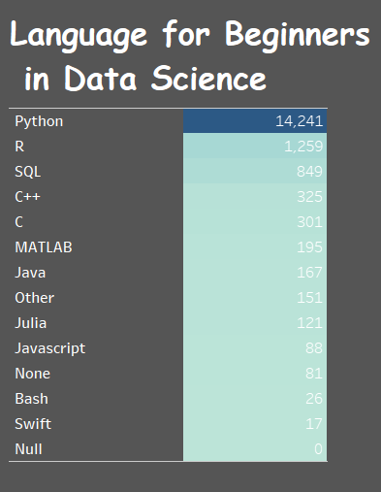
Language for Beginners in Data Science
Almost 70% of the total counts recommend Python as the most important language for beginners in data science field.
This indicates that Python is a easy programming language for the beginners to start their career and the most popular language in this field.

Slide 11
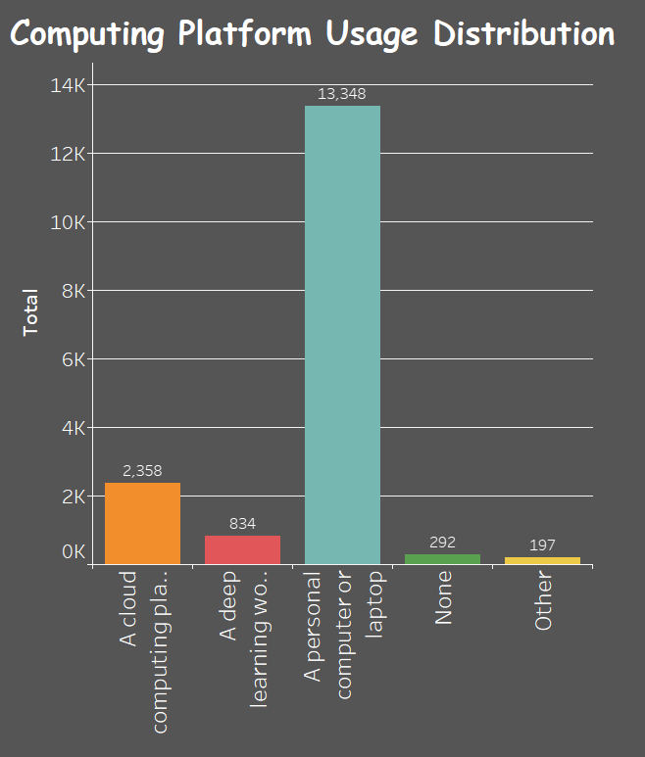
Computing Platform Usage Distribution
The most preferred computing platform is a personnel computer or laptop with a count of almost 13K survey participants.
A few people also use cloud computing platforms like AWS and Microsoft Azure.

Slide 12
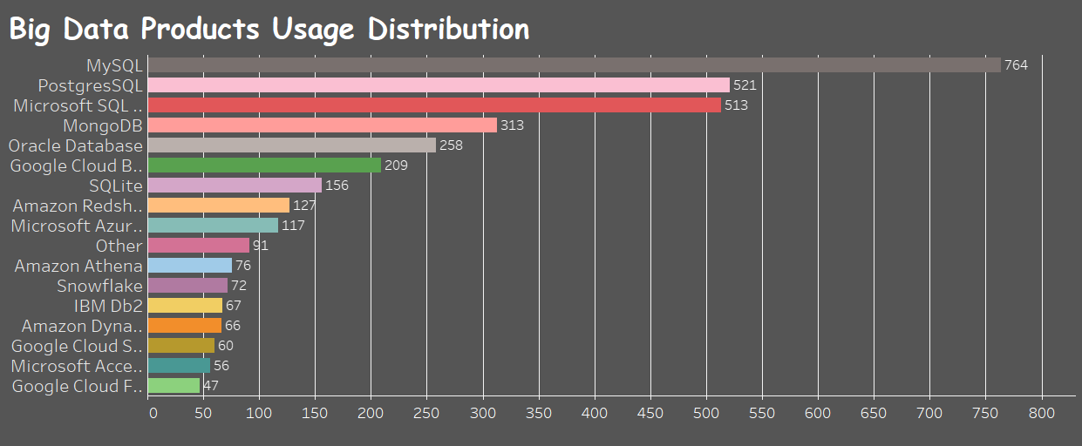
Big Data Products Usage Distribution
The most used Big Data products include MySQL, Postgres SQL, Microsoft SQL and MongoDB.
MySQL is the most used big data product with 764 in count.

Slide 13
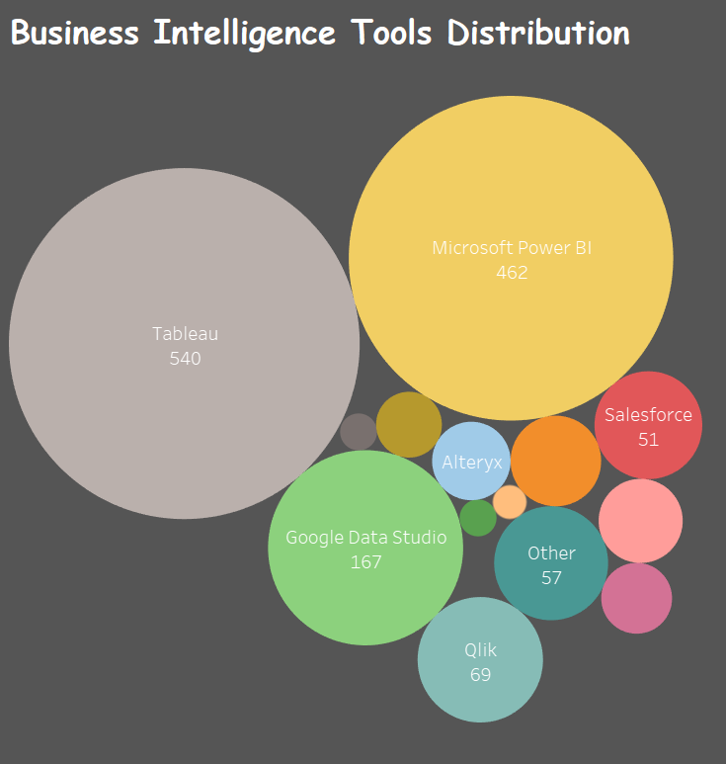
Business Intelligence Tools Distribution
The most popular Business Intelligence tools are Tableau and Microsoft Power BI.
More than 80% of the users use these 2 platforms for their insights derivation and Dashboard creation

Slide 14
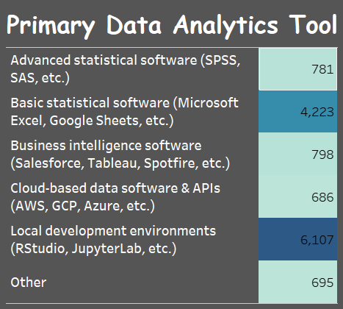
Primary Data Analytics Tool
The most used Data Analytics tools include Local development environments like Rstudio, JupyterLab etc. and basic statistical software like MS Excel, Google sheets etc.
These tools are open source and easy to use. Hence it’s the most preferred primary data analytics tool.

Slide 15
Money Spent on ML and Cloud Computing Services
About 1500-2000 survey participants have spent on the range of $100-999 and $1000-9999 respectively.
Almost 4000 participants have never spent any money on ML and cloud computing devices.

Slide 16
TPU Usage Distribution
72% of the total participants have never used TPU in their lifetime.
Only 2% of people have only used TPU for more than 25 times
11% of people have used TPU for one time.

Slide 17
Experience in Machine Learning Methods
About 6K survey participants have only 1 year experience in ML methods
There is a total of about 3.5K survey participants with 1-2 years experience in ML
There are only very few members with above 10years experience in using Machine Learning.

Slide 18
DASHBOARDS

Slide 19
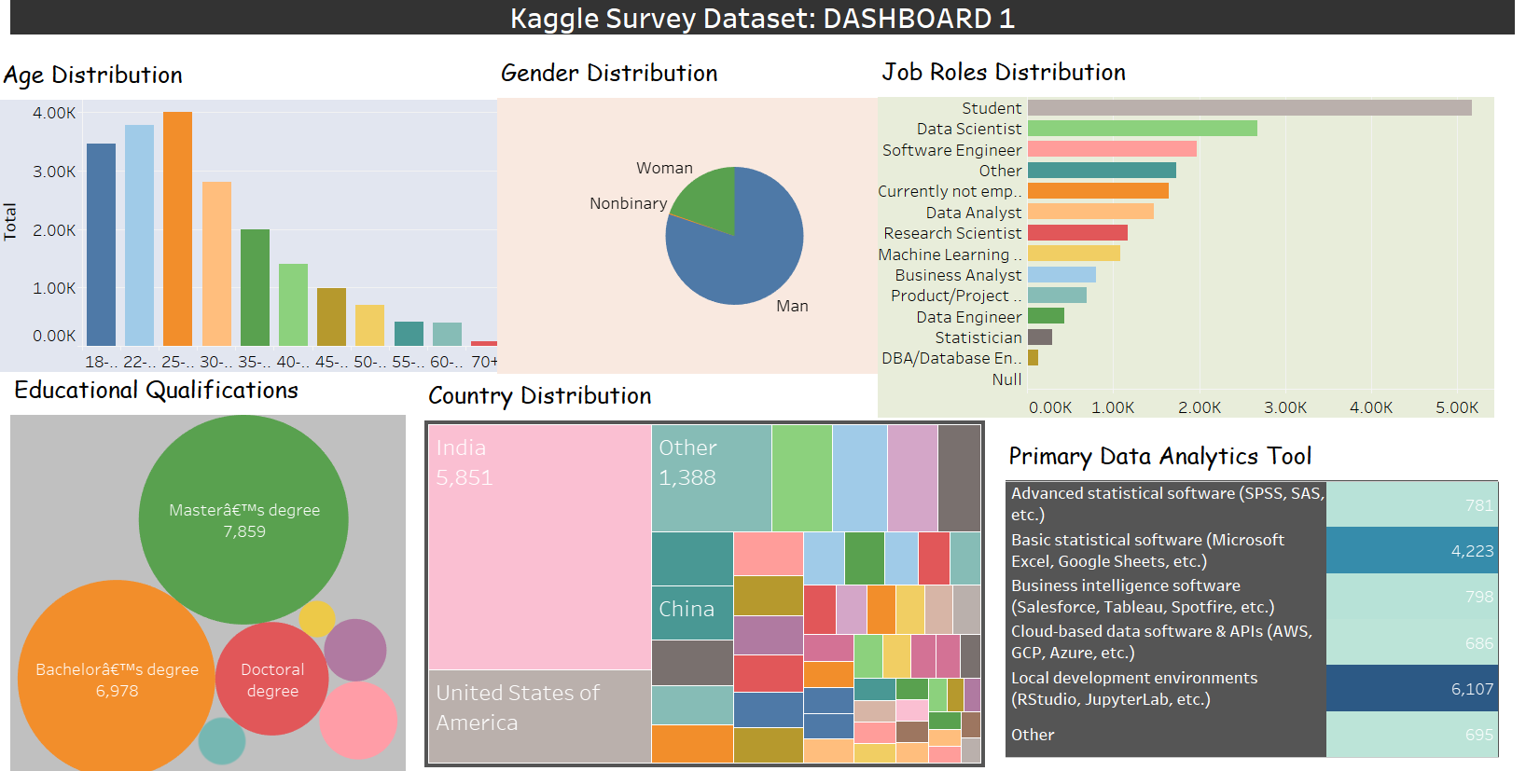

Slide 20
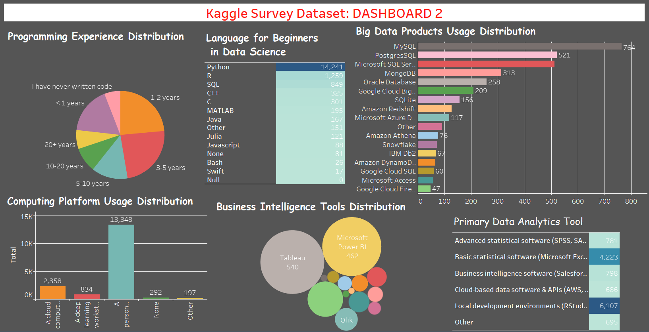

Slide 21
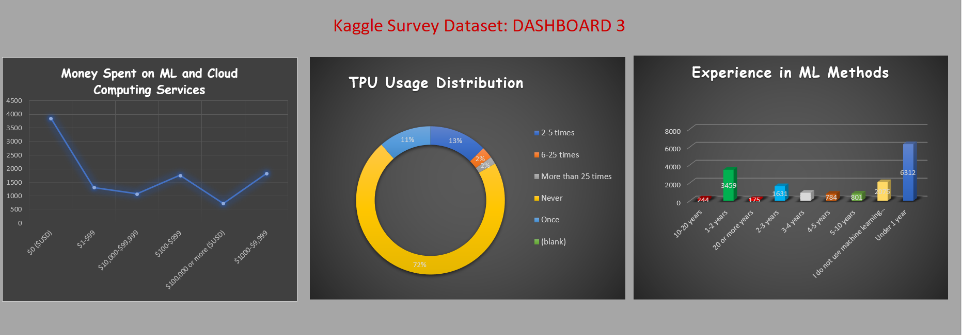
Dashboard constructed using Excel

Slide 22
THANK YOU

